Slide 1

What Makes a Movie?
An exploratory data analysis on movie metainformation
DataRes Winter 2021 Project by “Team Amigos”

Slide 2

Large diversity, uneven distribution
45% of movies collected are from the US
21.9% of US citizens do not consider English to be their main language
Only 20% of the World (including the US) speaks English

Slide 3
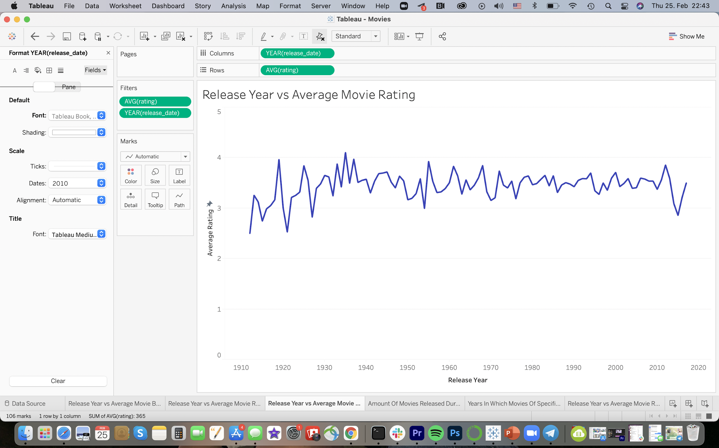
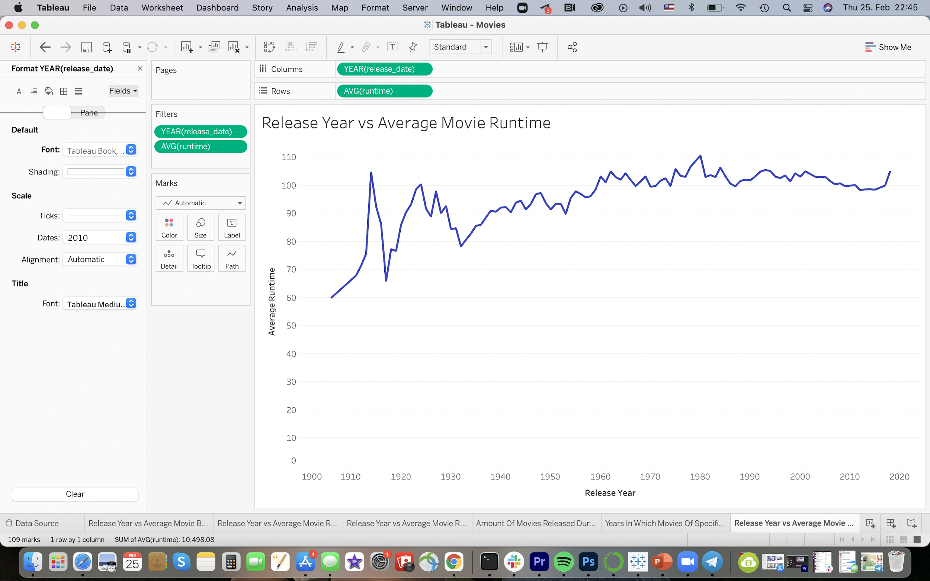
How Movie Ratings & Runtimes Have Changed Over Time
There has not been a significant change in the average movie ratings throughout the last 100+ years
It seems as though there has been a very slight increase in the average runtime of movies over the years

Slide 4



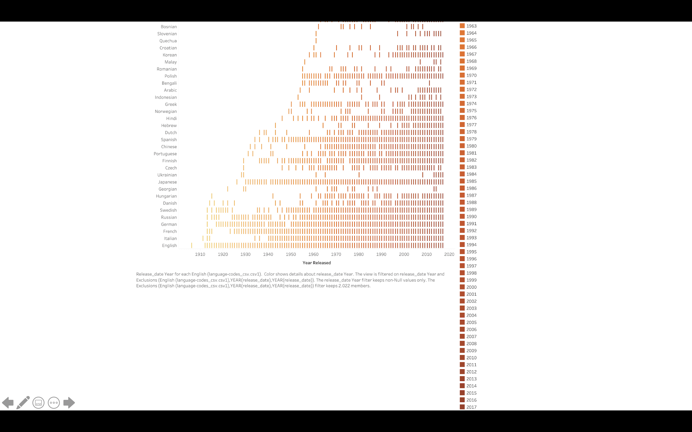

Slide 5
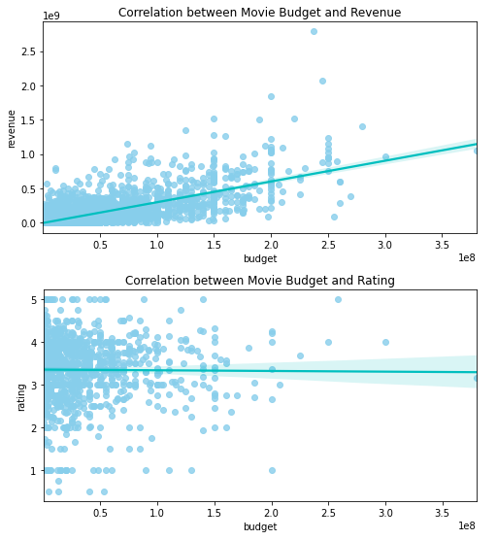
Movie Budget’s Influence on Revenue and Ratings
Average revenue-to-budget ratio: 1391.73
Movie with most revenue: Avatar
Movie with highest budget: Pirates of the Caribbean: On Stranger Tides
Movie budget has very little influence on its ratings

Slide 6
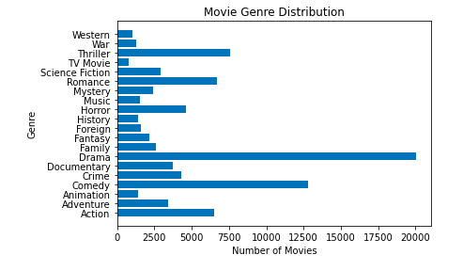
Movie Genres Distribution
Movie genre with highest # of movies: Drama
Thriller, Romance, Comedy, Action also popular
Most movies had multiple genres

Slide 7




Popular Keywords
Horror Movies
Action Movies
Romance Movies

Slide 8
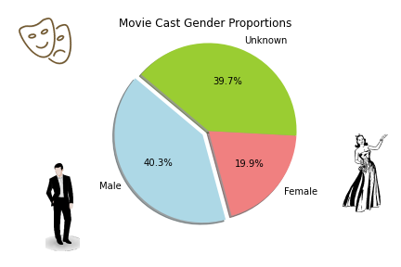
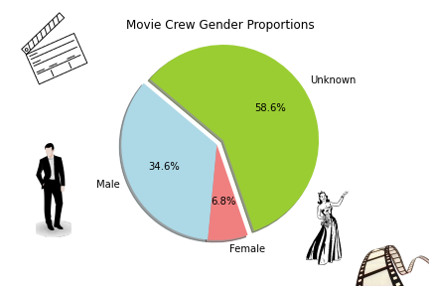
Movie Cast/Credits
The majority of cast and crew members are male (even with the large unknown proportion we still expect males to make up the majority based on past trends)
Looking forward to increased diversity in the movie production process

Slide 9
Release Dates and Languages
This visual illustrates when movies of specific languages were released
We can see that movies in English were produced very early on, and they have been released almost every year since 1906
Movies in Punjabi, Maltese, and Inuktitut were the last to be produced (this is specific to the dataset we are working with)

Slide 10
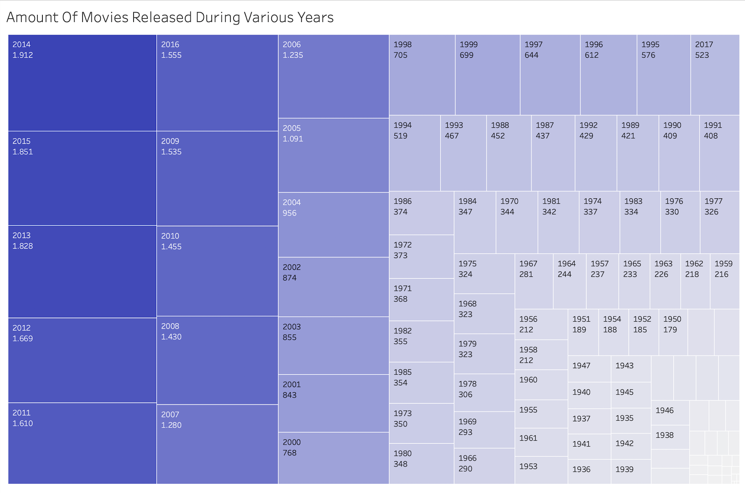
Number of Movies Released Throughout the Years
The number of movies released has increased with time
The largest number of movies released was in 2014, with 1912 movies produced
The smallest number was in 1911, with only 1 movie produced

Slide 11
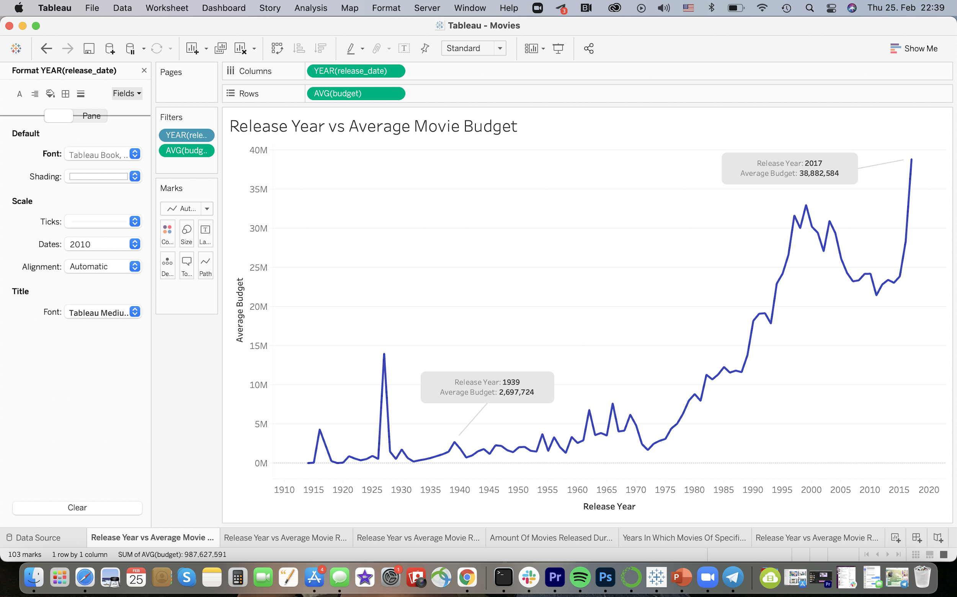
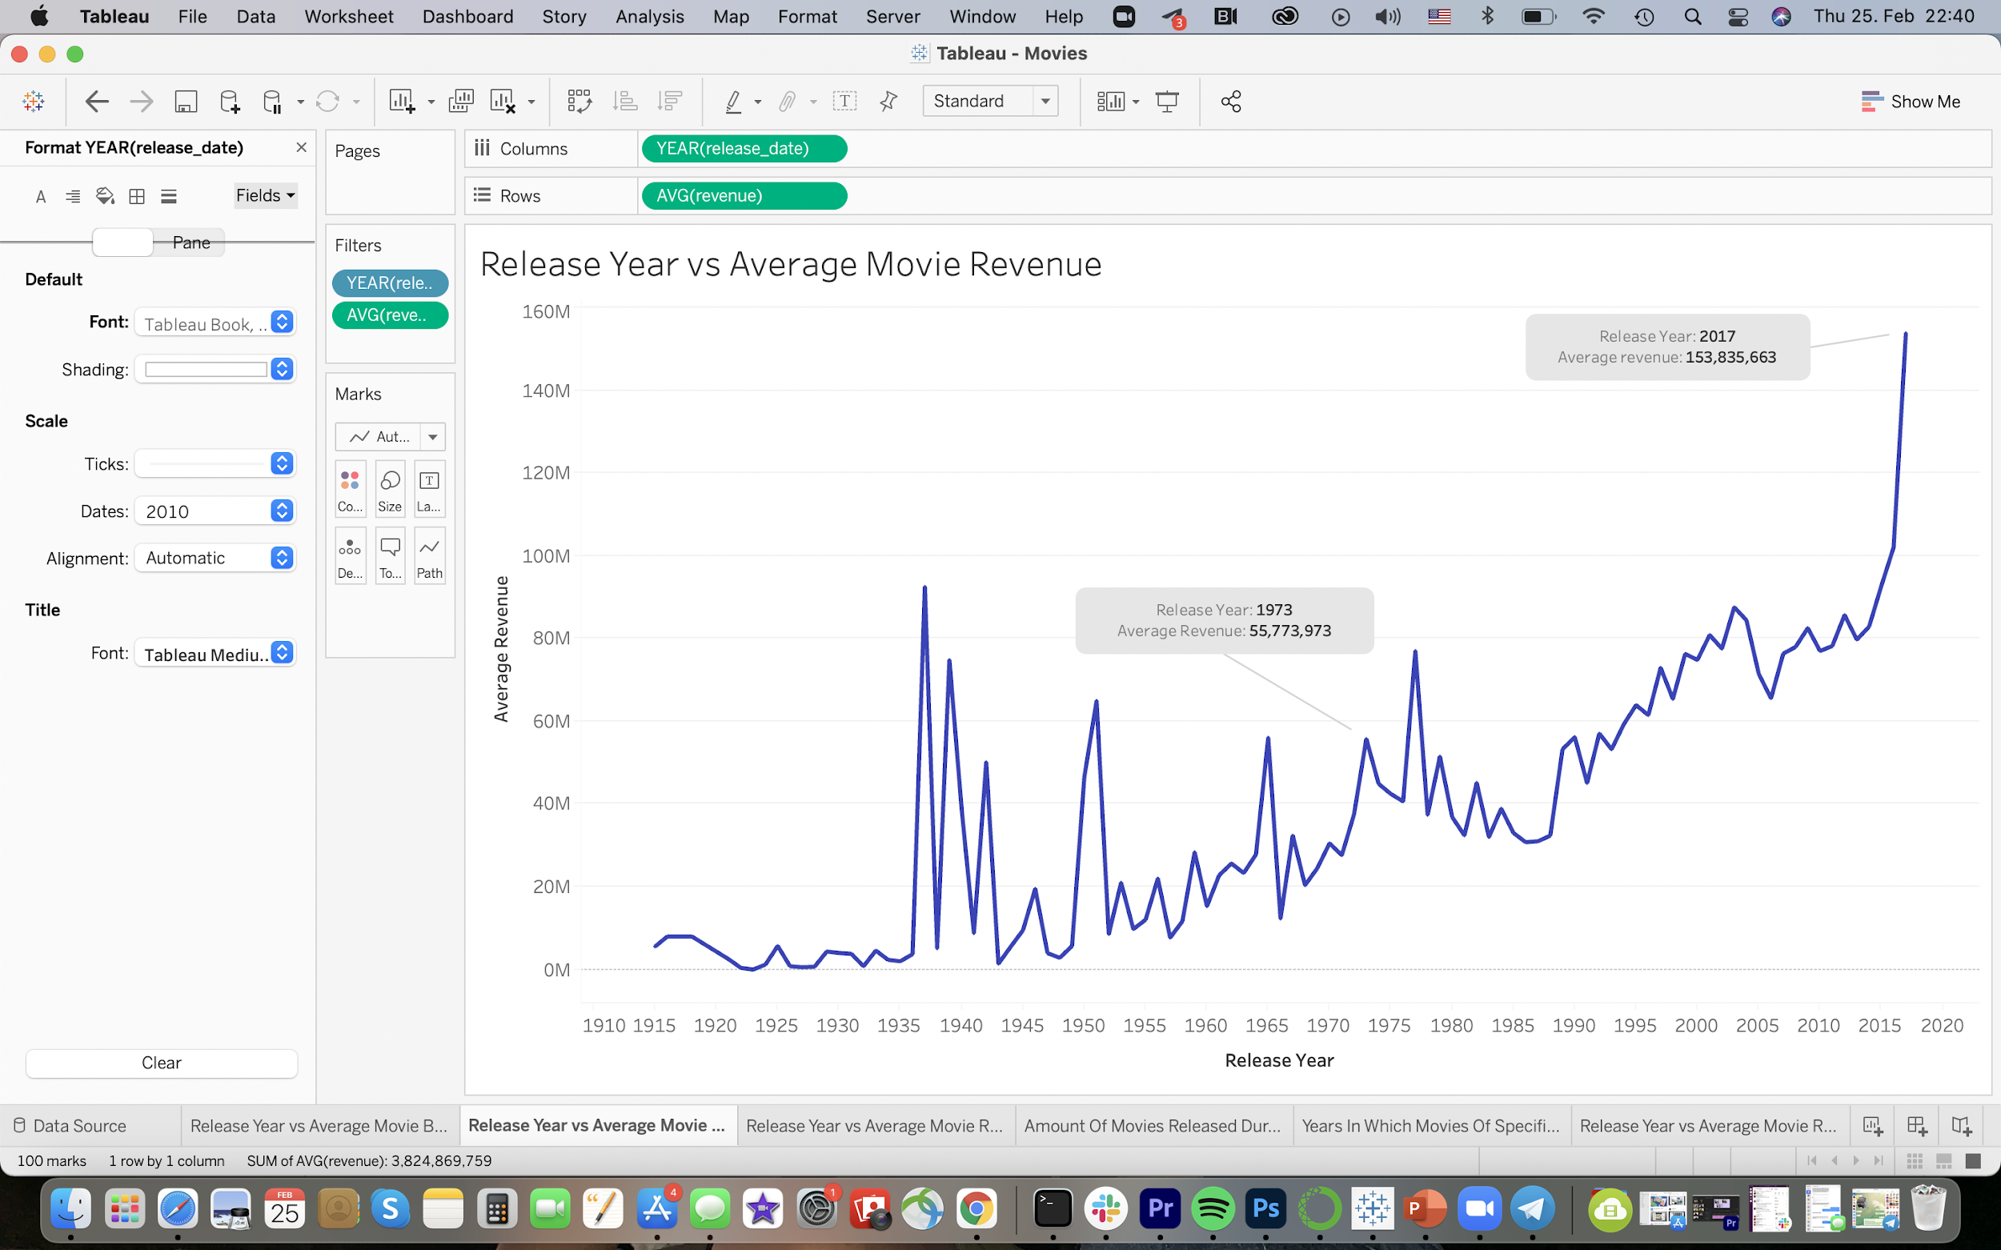
How Movie Budgets & Revenues Have Changed Over Time
Over the past 100+ years, movie budgets and revenues have significantly increased
The movie with the highest budget, Pirates of the Caribbean: On Stranger Tides, was released in 2011
The movie with the highest revenue, Avatar, was released in 2009

